Slide 1
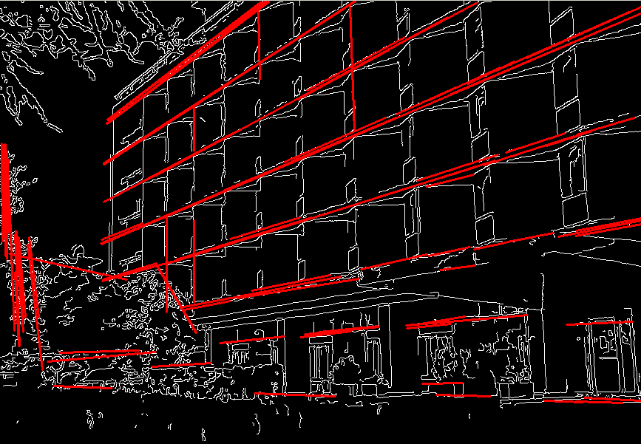
Fitting
Slides are from Svetlana Lazebnik

Slide 2
Fitting

Slide 3
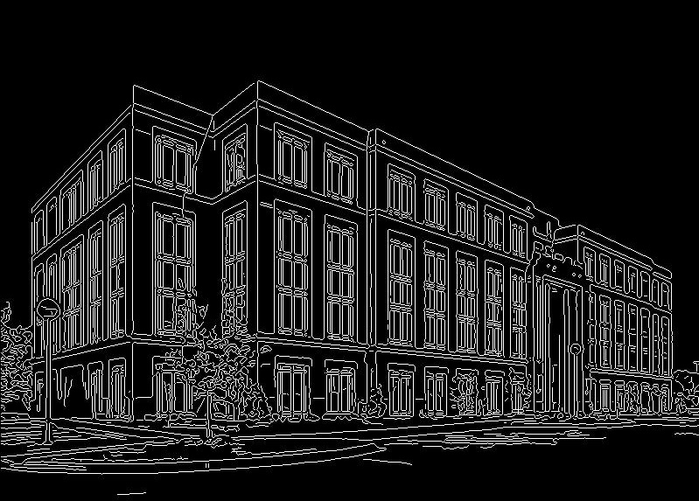
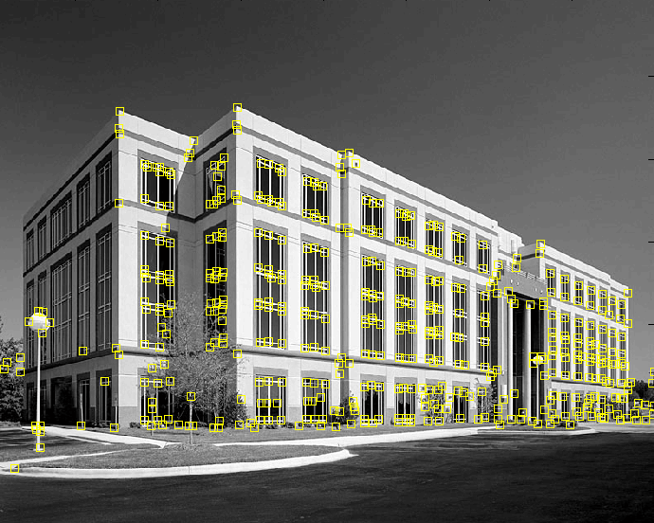
Fitting
We’ve learned how to detect edges, corners, blobs. Now what?
We would like to form a higher-level, more compact representation of the features in the image by grouping multiple features according to a simple model

Slide 4
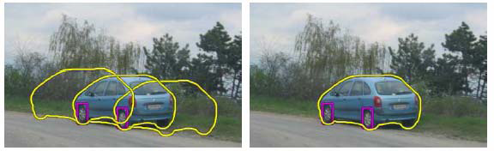
Fitting
Choose a parametric model to represent a set of features
simple model: lines
simple model: circles
complicated model: car
Source: K. Grauman

Slide 5
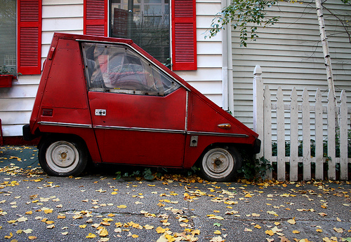
Fitting: Challenges
Case study: Line detection
Noise in the measured feature locations
Extraneous data: clutter (outliers), multiple lines
Missing data: occlusions

Slide 6
Fitting: Overview
Least squares line fitting
Robust fitting
RANSAC
Hough transform
Generalized Hough transform

Slide 7
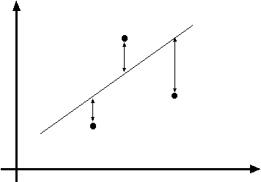
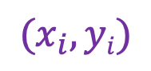
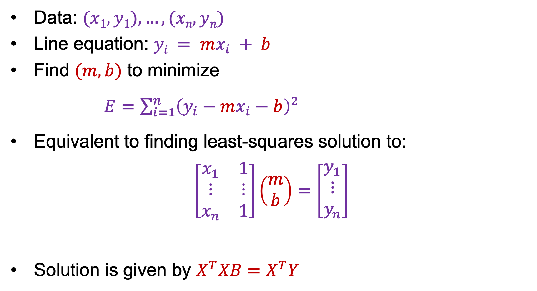



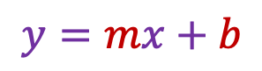
Least squares line fitting: First attempt
Data: $(x1, y1), …, (xn, yn)$
Line equation: $yi = mx_{i} + b$
Find $(m, b)$ to minimize
$E=\sum_{i=1}^{n}{{\left(y_{i}−mx_{i}−b\right)}^{2}}$
Equivalent to finding least-squares solution to:
$$\left[\begin{matrix}x_{1} & 1 \\ ⋮ & ⋮ \\ x_{n} & 1\end{matrix}\right]\left(\begin{aligned}m \\ b\end{aligned}\right)=\left[\begin{aligned}y_{1} \\ ⋮ \\ y_{n}\end{aligned}\right]$$
Solution is given by $X^{T}XB=X^{T}Y$
$$y=mx+b$$
$$(x_{i}, yi)$$
$$X$$
$$B$$
$$Y$$

Slide 8
Is this a good solution?
Slope-intercept parametrization fails for vertical lines
Solution is not equivariant w.r.t. rotation

Slide 9
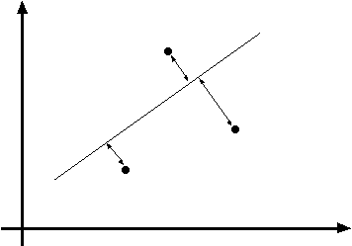
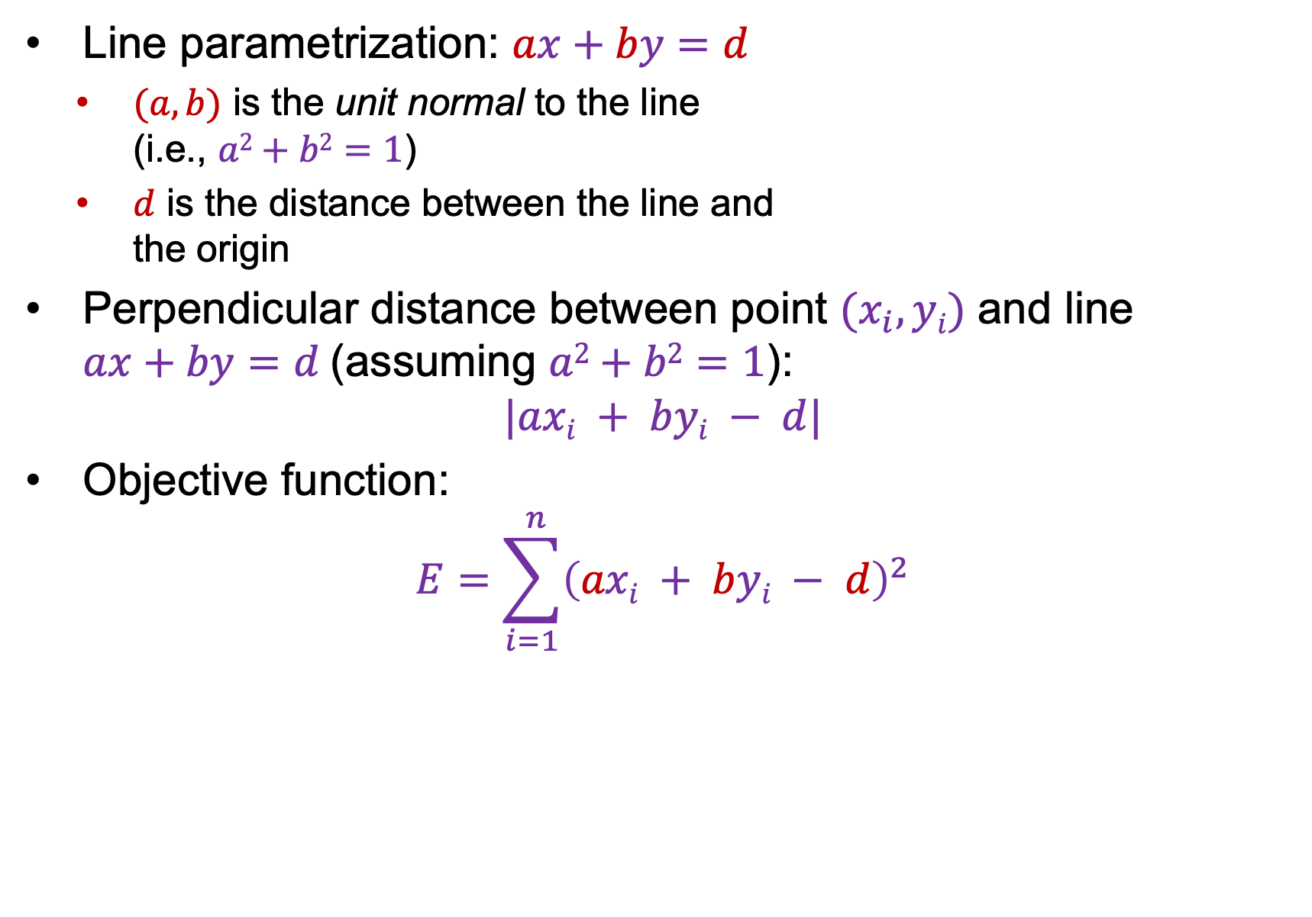
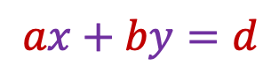
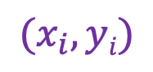
Total least squares
$$ax+by=d$$
Line parametrization: $ax+by=d$
$(a,b)$ is the unit normal to the line (i.e., $a2+b2=1$)
$d$ is the distance between the line and the origin
Perpendicular distance between point $(x_{i}, yi)$ and line $ax+by=d$ (assuming $a2+b2=1$):
$$|axi + byi − d|$$
Objective function:
$$E=\sum_{i=1}^{ n}{{\left(axi + byi − d\right)}^{2}}$$
$$(x_{i}, yi)$$

Slide 10
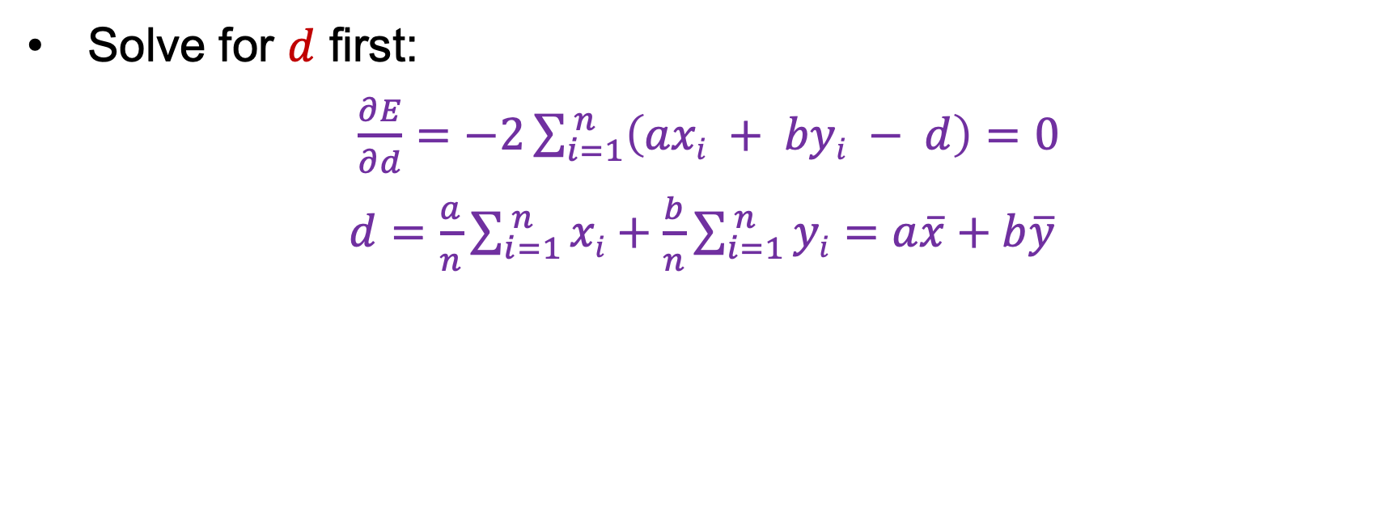
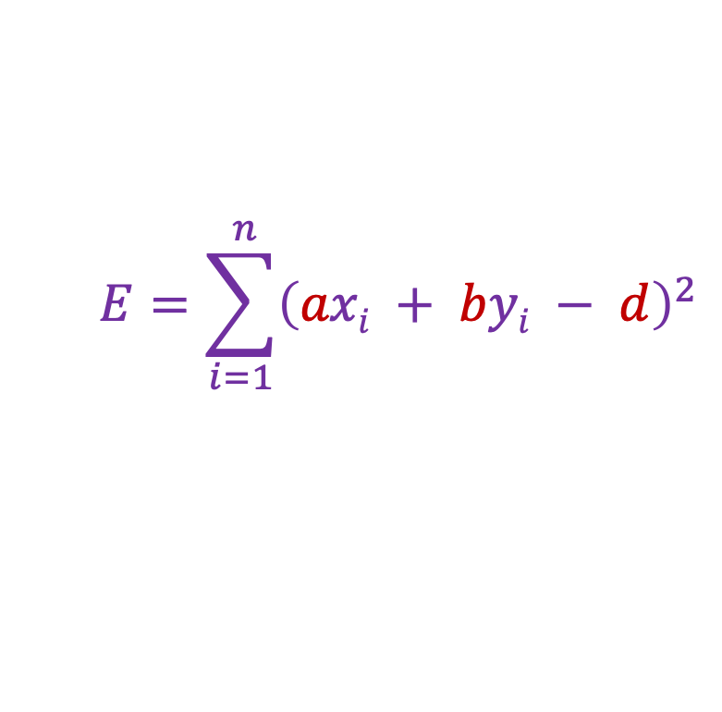
Total least squares
$$E=\sum_{i=1}^{ n}{{\left(axi + byi − d\right)}^{2}}$$
$$ax+by=d$$
$$(x_{i}, yi)$$
Solve for $d$ first:
$\frac{∂E}{∂d}=−2\sum_{i=1}^{ n}{\left(axi + byi − d\right)}=0$
$d=\frac{a}{n}\sum_{i=1}^{ n}{xi}+\frac{b}{n}\sum_{i=1}^{ n}{yi}$ $=a\overline{x}+b\overline{y}$

Slide 11
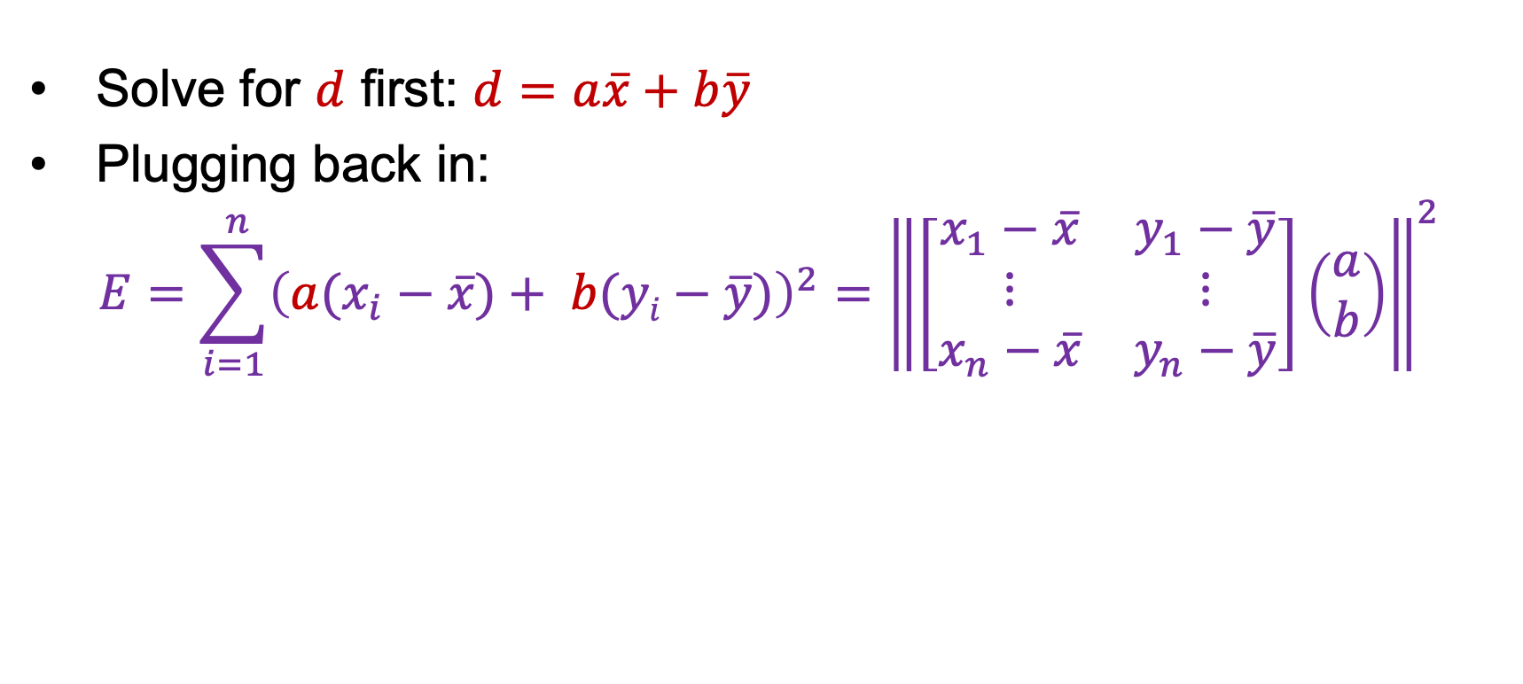
Total least squares
$$E=\sum_{i=1}^{ n}{{\left(axi + byi − d\right)}^{2}}$$
$$ax+by=d$$
$$(x_{i}, yi)$$
Solve for $d$ first: $d$ $=a\overline{x}+b\overline{y}$
Plugging back in:
$$E=\sum_{i=1}^{ n}{{\left(a(x_{i}−\overline{x})+ b(yi−\overline{y})\right)}^{2}}={\left\|\left[\begin{matrix}x_{1}−\overline{x} & y_{1}−\overline{y} \\ ⋮ & ⋮ \\ x_{n}−\overline{x} & y_{n}−\overline{y}\end{matrix}\right]\left(\begin{aligned}a \\ b\end{aligned}\right)\right\|}^{2}$$

Slide 12

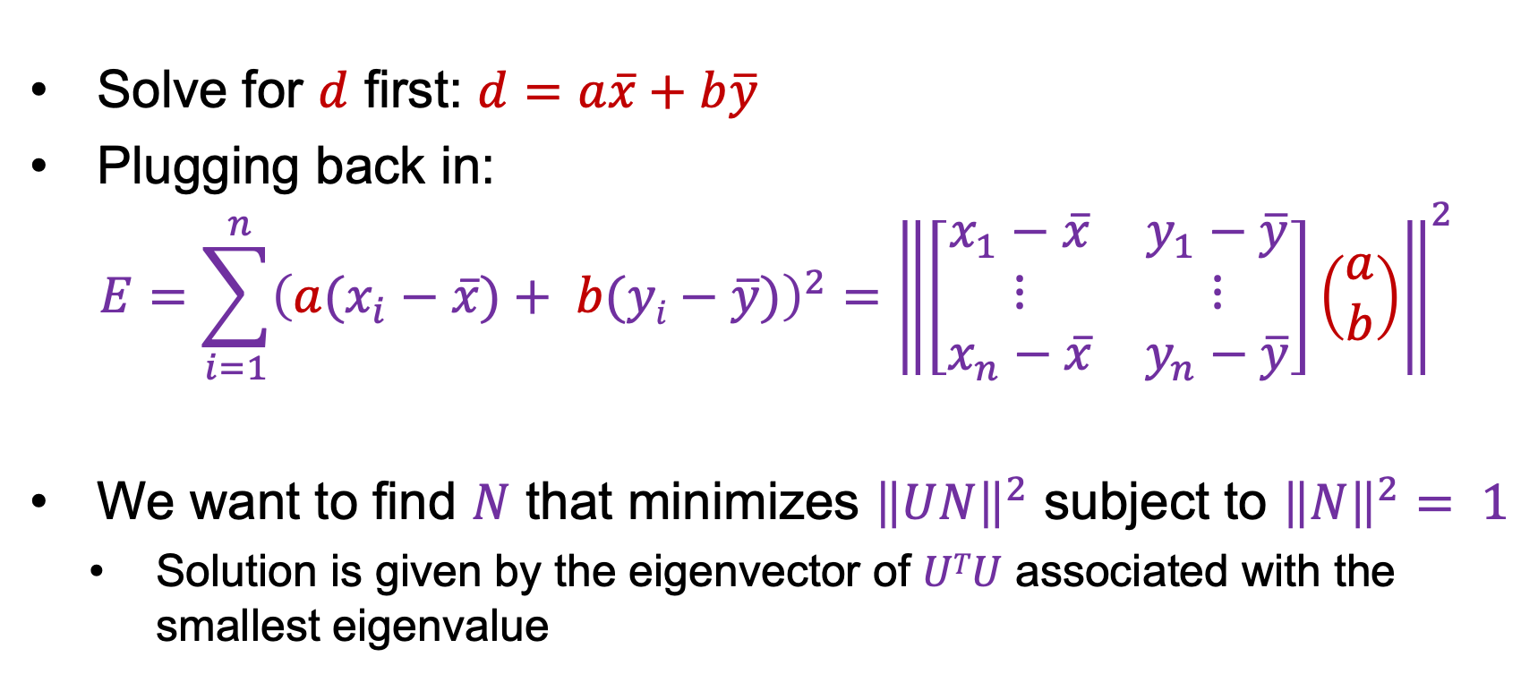
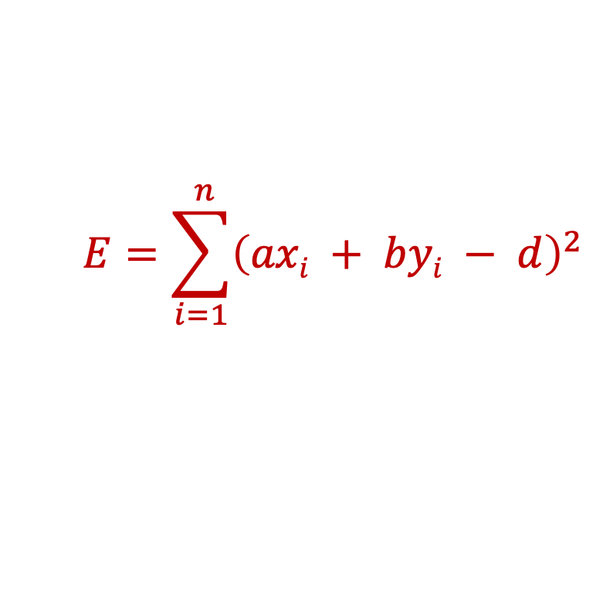

Total least squares
$$E=\sum_{i=1}^{ n}{{\left(axi + byi − d\right)}^{2}}$$
$$ax+by=d$$
$$(x_{i}, yi)$$
Solve for $d$ first: $d$ $=a\overline{x}+b\overline{y}$
Plugging back in:
$$E=\sum_{i=1}^{ n}{{\left(a(x_{i}−\overline{x})+ b(yi−\overline{y})\right)}^{2}}={\left\|\left[\begin{matrix}x_{1}−\overline{x} & y_{1}−\overline{y} \\ ⋮ & ⋮ \\ x_{n}−\overline{x} & y_{n}−\overline{y}\end{matrix}\right]\left(\begin{aligned}a \\ b\end{aligned}\right)\right\|}^{2}$$
We want to find $N$ that minimizes ${\left\|UN\right\|}^{2}$ subject to ${\left\|N\right\|}^{2}= 1$
Solution is given by the eigenvector of $UTU$ associated with the smallest eigenvalue
$$U$$
$$N$$

Slide 13
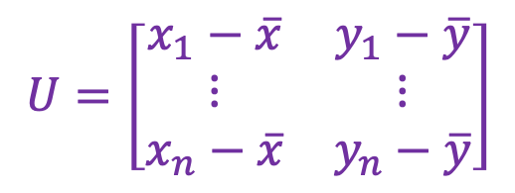
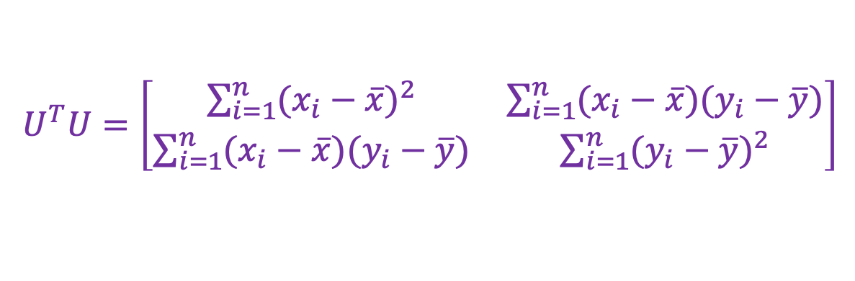
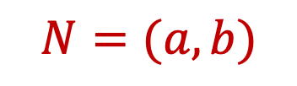
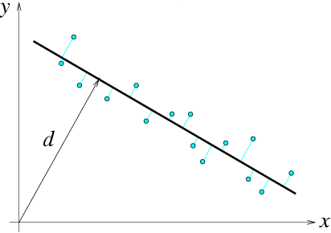
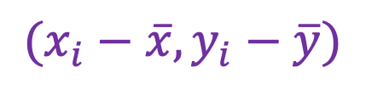
Total least squares
$$U=\left[\begin{matrix}x_{1}−\overline{x} & y_{1}−\overline{y} \\ ⋮ & ⋮ \\ x_{n}−\overline{x} & y_{n}−\overline{y}\end{matrix}\right]$$
$U^{T}U=\left[\begin{matrix}\sum_{i=1}^{n}{{(x_{i}−\overline{x})}^{2}} & \sum_{i=1}^{n}{(x_{i}−\overline{x})(y_{i}−\overline{y})} \\ \sum_{i=1}^{n}{(x_{i}−\overline{x})(y_{i}−\overline{y})} & \sum_{i=1}^{n}{{(y_{i}−\overline{y})}^{2}}\end{matrix}\right]$
second moment matrix
$$N=(a, b)$$
$$(x_{i}−\overline{x},y_{i}−\overline{y})$$
F&P (2nd ed.) sec. 22.1

Slide 14
Least squares as likelihood maximization
Generative model: line points are sampled independently and corrupted by Gaussian noise in the direction perpendicular to the line
ax+by=d
(u, v)
ε
(x, y)
point on the line
normal direction
noise: sampled from zero-mean Gaussian with std. dev. σ

Slide 15
Least squares as likelihood maximization
Generative model: line points are sampled independently and corrupted by Gaussian noise in the direction perpendicular to the line
ax+by=d
(u, v)
ε
(x, y)
Likelihood of points given line parameters (a, b, d):
Log-likelihood:

Slide 16
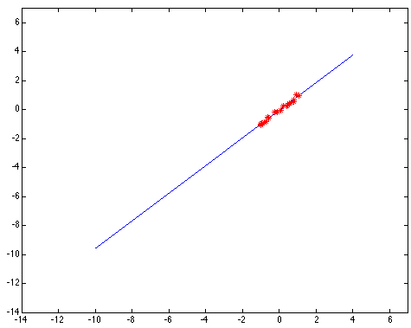
Least squares: Robustness to noise
Least squares fit to the red points:

Slide 17
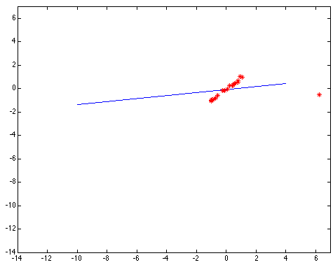
Least squares: Robustness to noise
Least squares fit with an outlier:
Problem: squared error heavily penalizes outliers

Slide 18
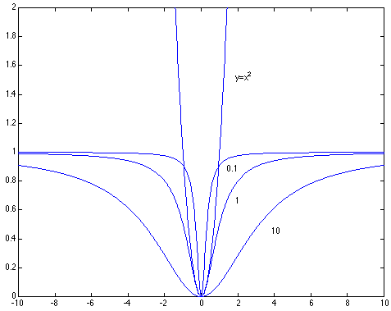
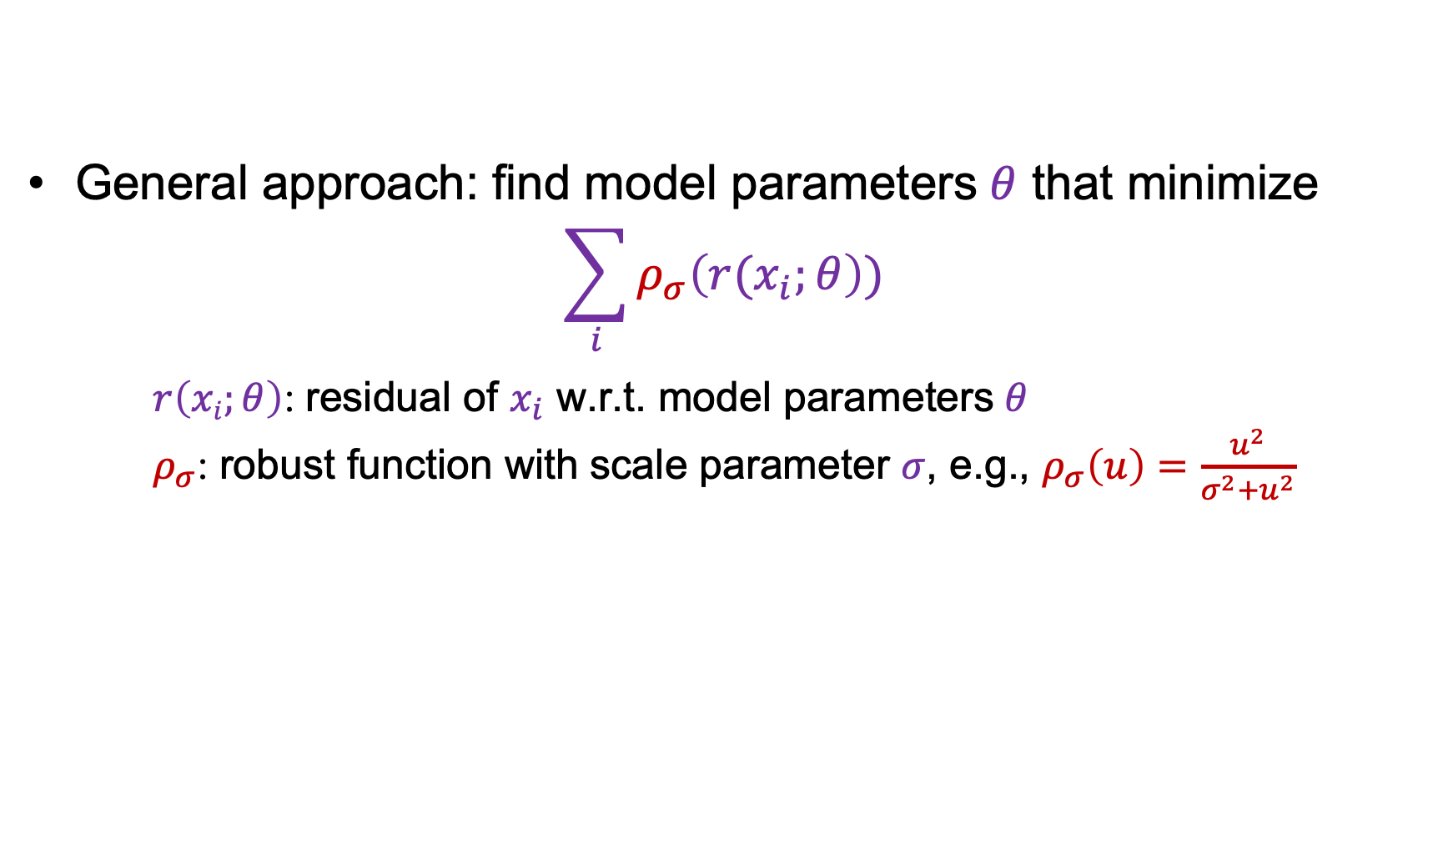
Robust estimators
General approach: find model parameters $θ$ that minimize
$$\sum_{i}{ρ_{σ}\left(r(x_{i};θ\right))}$$ $r\left(xi;θ\right)$: residual of $x_{i}$ w.r.t. model parameters $θ$ $ρ_{σ}$: robust function with scale parameter $σ$, e.g., $ρ_{σ}\left(u\right)=\frac{u^{2}}{σ^{2}+u^{2}}$

Slide 19
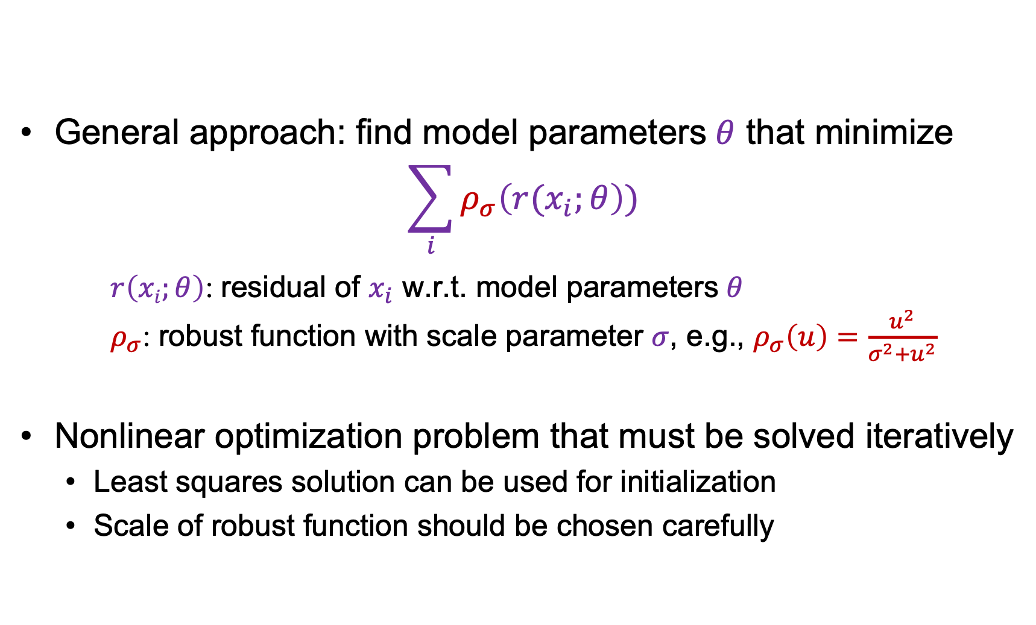
Robust estimators
General approach: find model parameters $θ$ that minimize
$$\sum_{i}{ρ_{σ}\left(r(x_{i};θ\right))}$$ $r\left(xi;θ\right)$: residual of $x_{i}$ w.r.t. model parameters $θ$ $ρ_{σ}$: robust function with scale parameter $σ$, e.g., $ρ_{σ}\left(u\right)=\frac{u^{2}}{σ^{2}+u^{2}}$
Nonlinear optimization problem that must be solved iteratively
Least squares solution can be used for initialization
Scale of robust function should be chosen carefully

Slide 20

Choosing the scale: Just right
The effect of the outlier is minimized
Notes:
Fit to earlier data with an appropriate choice of s

Slide 21
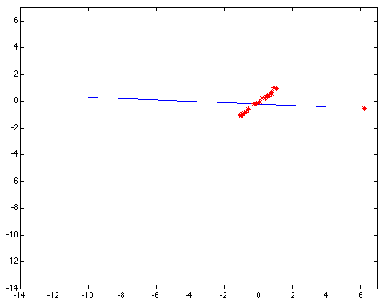
Choosing the scale: Too small
The error value is almost the same for every point and the fit is very poor

Slide 22

Choosing the scale: Too large
Behaves much the same as least squares

Slide 23
Fitting: Overview
Least squares line fitting
Robust fitting
RANSAC

Slide 24
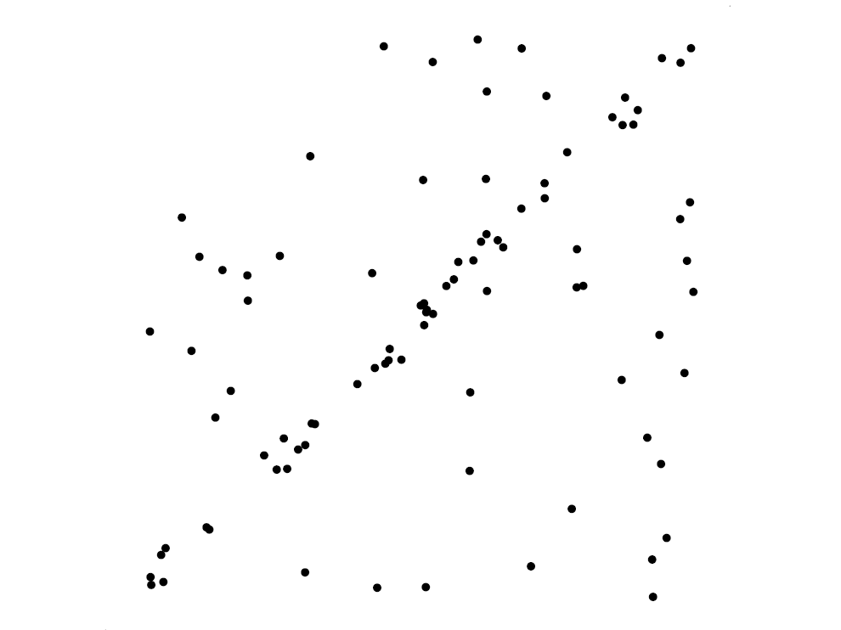
Voting schemes
Robust fitting can deal with a few outliers – what if we have very many?
Basic idea: let each point vote for all the models that are compatible with it
Hopefully the outliers will not vote consistently for any single model
The model that receives the most votes is the best fit to the image

Slide 25
RANSAC
Random sample consensus: very general framework for model fitting in the presence of outliers
Outline:
Randomly choose a small initial subset of points
Fit a model to that subset
Find all inlier points that are “close” to the model and reject the rest as outliers
Do this many times and choose the model with the most inliers
M. Fischler and R. Bolles. Random Sample Consensus: A Paradigm for Model Fitting with Applications to Image Analysis and Automated Cartography. Comm. of the ACM, Vol 24, pp 381-395, 1981

Slide 26
RANSAC for line fitting example
Source: R. Raguram

Slide 27
RANSAC for line fitting example
Least-squares fit
Source: R. Raguram

Slide 28
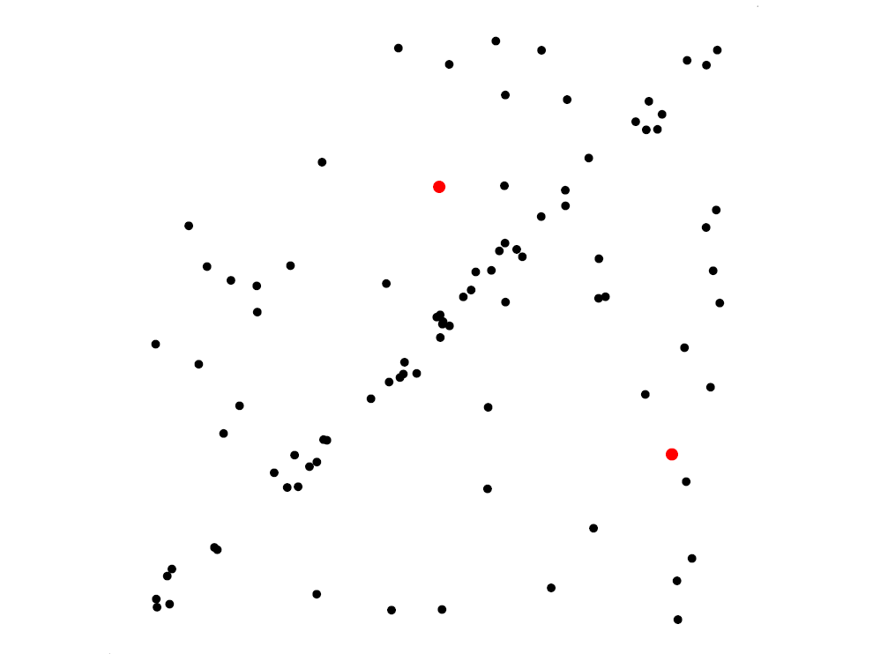
RANSAC for line fitting example
Randomly select minimal subset of points
Source: R. Raguram

Slide 29
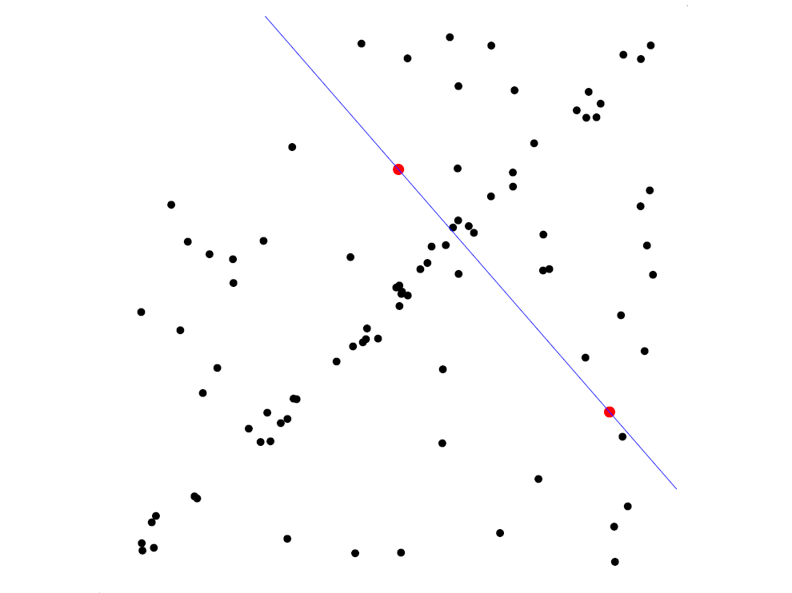
RANSAC for line fitting example
Randomly select minimal subset of points
Hypothesize a model
Source: R. Raguram

Slide 30
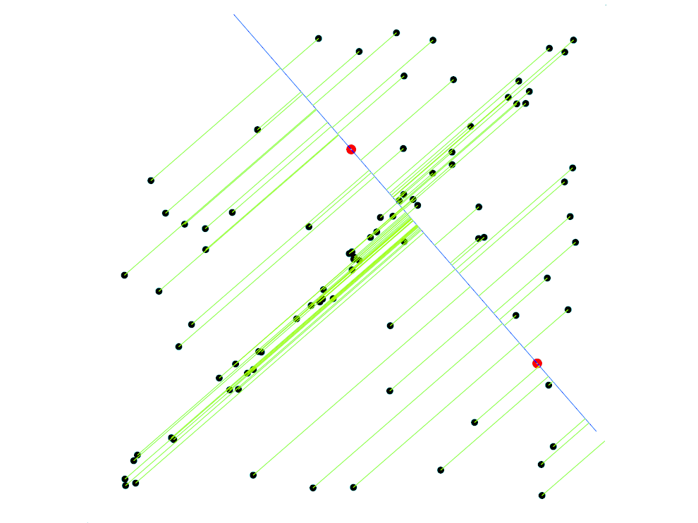
RANSAC for line fitting example
Randomly select minimal subset of points
Hypothesize a model
Compute error function
Source: R. Raguram

Slide 31
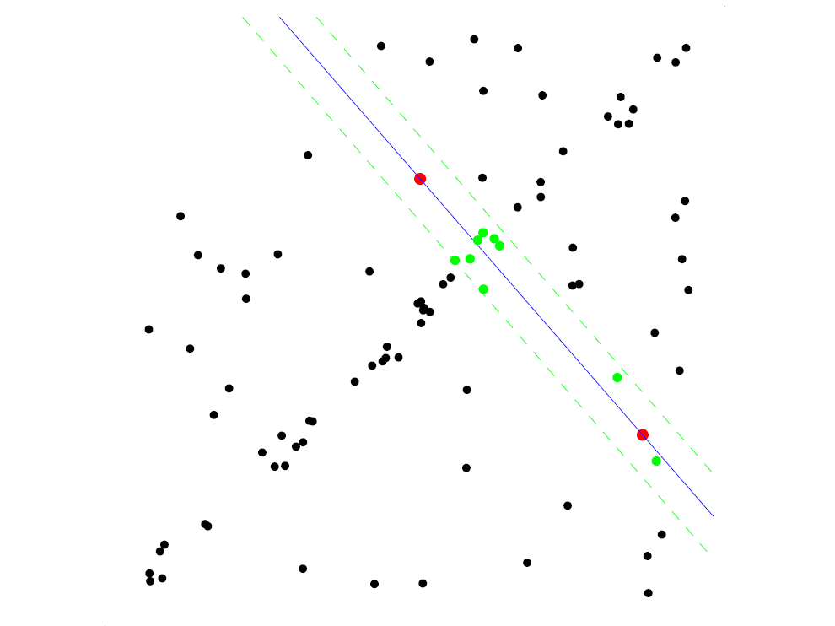
RANSAC for line fitting example
Randomly select minimal subset of points
Hypothesize a model
Compute error function
Select points consistent with model
Source: R. Raguram

Slide 32
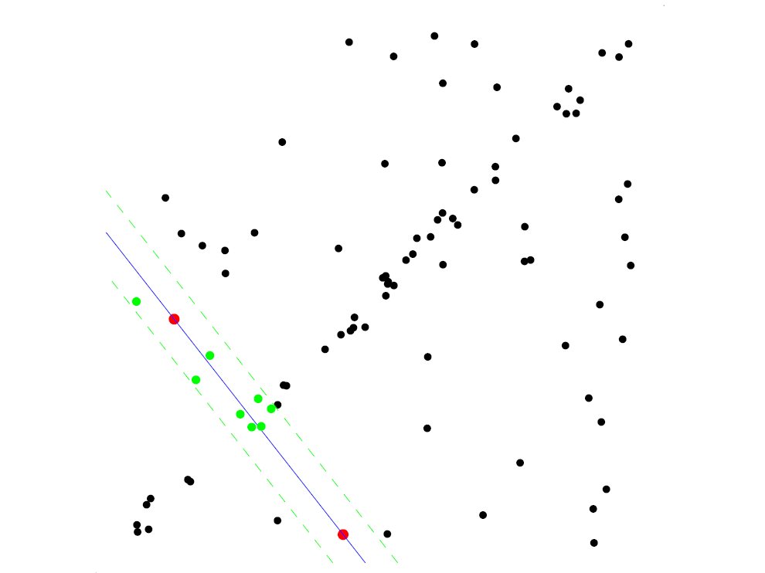
RANSAC for line fitting example
Randomly select minimal subset of points
Hypothesize a model
Compute error function
Select points consistent with model
Repeat hypothesize-and-verify loop
Source: R. Raguram

Slide 33
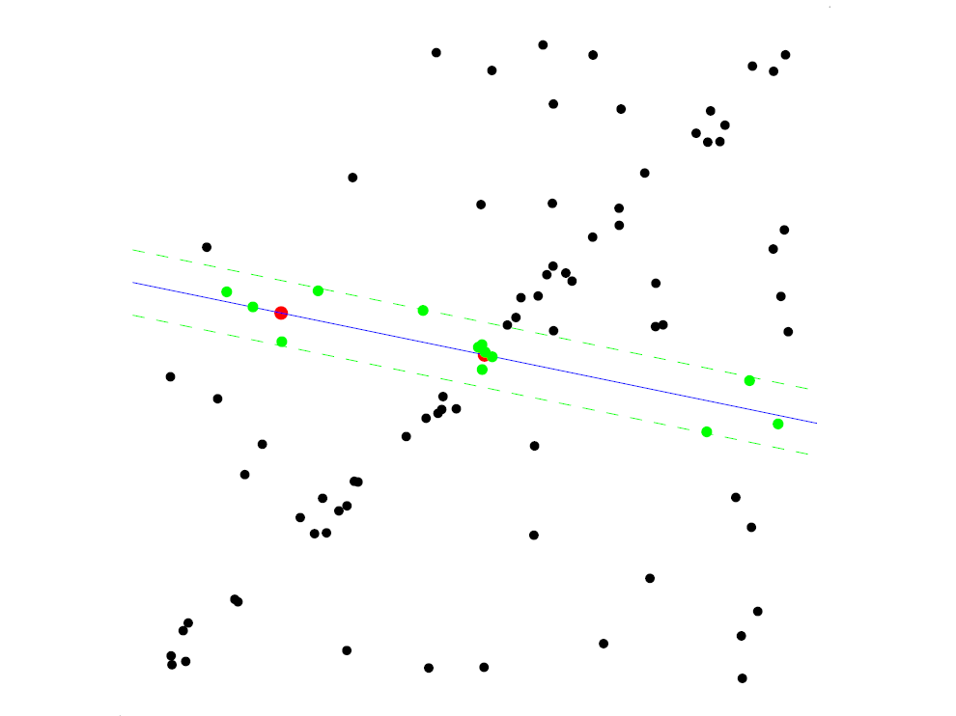
RANSAC for line fitting example
Randomly select minimal subset of points
Hypothesize a model
Compute error function
Select points consistent with model
Repeat hypothesize-and-verify loop
Source: R. Raguram

Slide 34
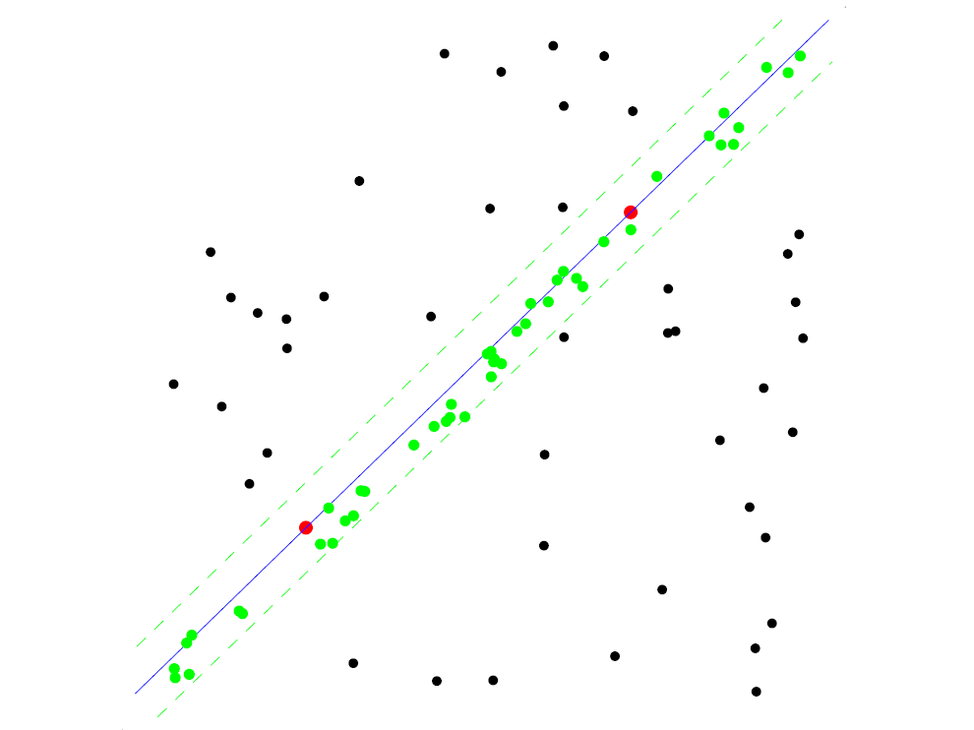
RANSAC for line fitting example
Uncontaminated sample
Randomly select minimal subset of points
Hypothesize a model
Compute error function
Select points consistent with model
Repeat hypothesize-and-verify loop
Source: R. Raguram

Slide 35
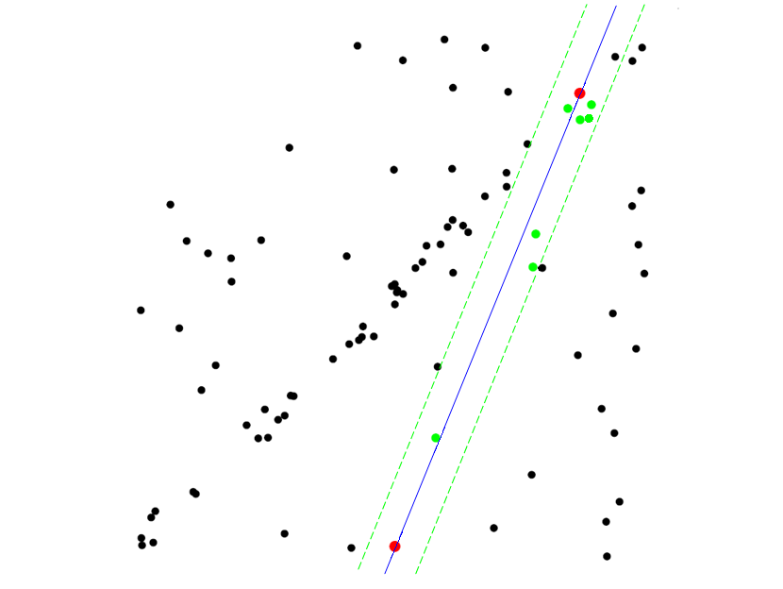
RANSAC for line fitting example
Randomly select minimal subset of points
Hypothesize a model
Compute error function
Select points consistent with model
Repeat hypothesize-and-verify loop
Source: R. Raguram
Notes:
35

Slide 36
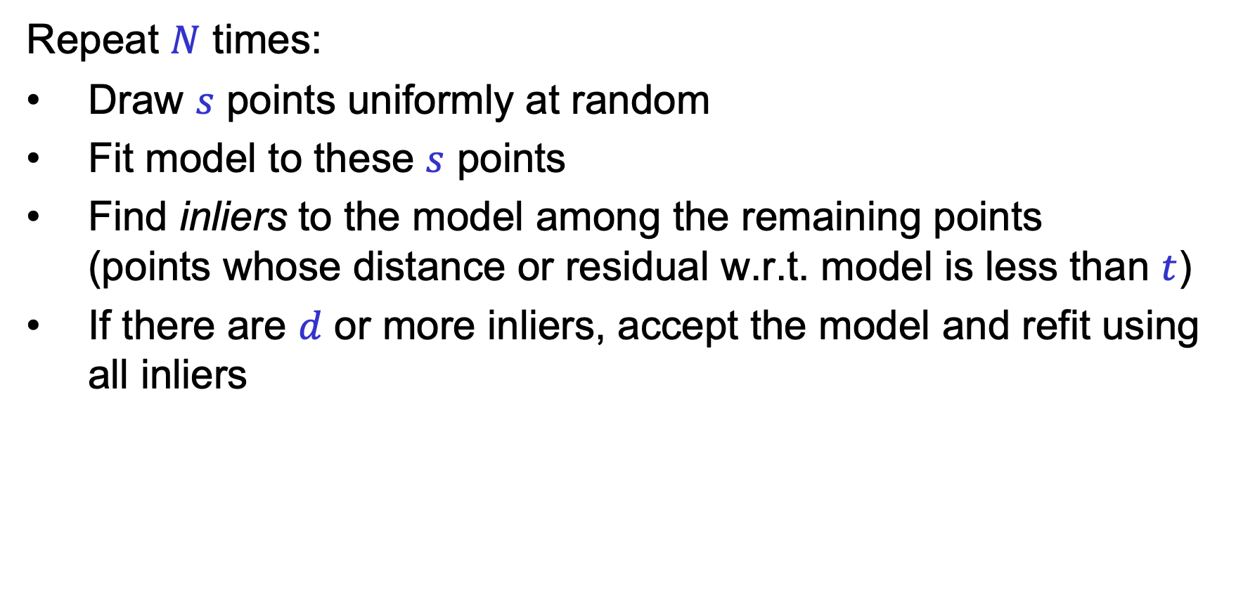
RANSAC: Choosing the parameters
Repeat $N$ times:
Draw $s$ points uniformly at random
Fit model to these $s$ points
Find inliers to the model among the remaining points (points whose distance or residual w.r.t. model is less than $t$)
If there are $d$ or more inliers, accept the model and refit using all inliers

Slide 37
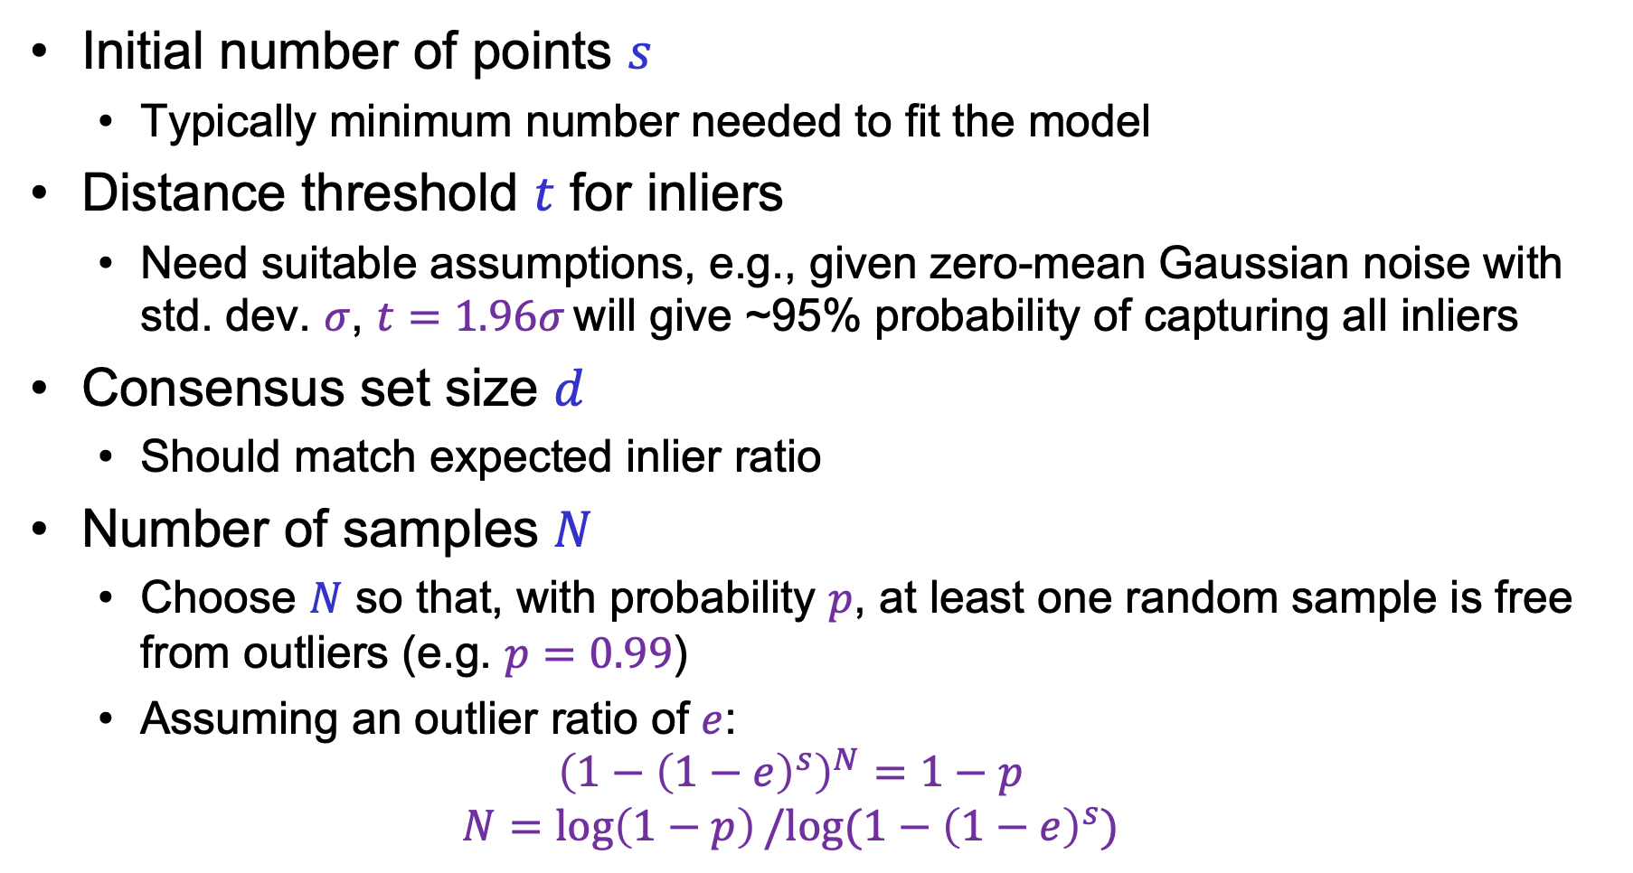
RANSAC: Choosing the parameters
Initial number of points $s$
Typically minimum number needed to fit the model
Distance threshold $t$ for inliers
Need suitable assumptions, e.g., given zero-mean Gaussian noise with std. dev. $σ$, $t=1.96σ$ will give ~95% probability of capturing all inliers
Consensus set size $d$
Should match expected inlier ratio
Number of samples $N$
Choose $N$ so that, with probability $p$, at least one random sample is free from outliers (e.g. $p=0.99$)
Assuming an outlier ratio of $e$:
$${\left(1−{\left(1−e\right)}^{s}\right)}^{N}=1−p$$
$$N=\log\left(1−p\right)/log⁡(1−{\left(1−e\right)}^{s})$$
Adapted from M. Pollefeys

Slide 38
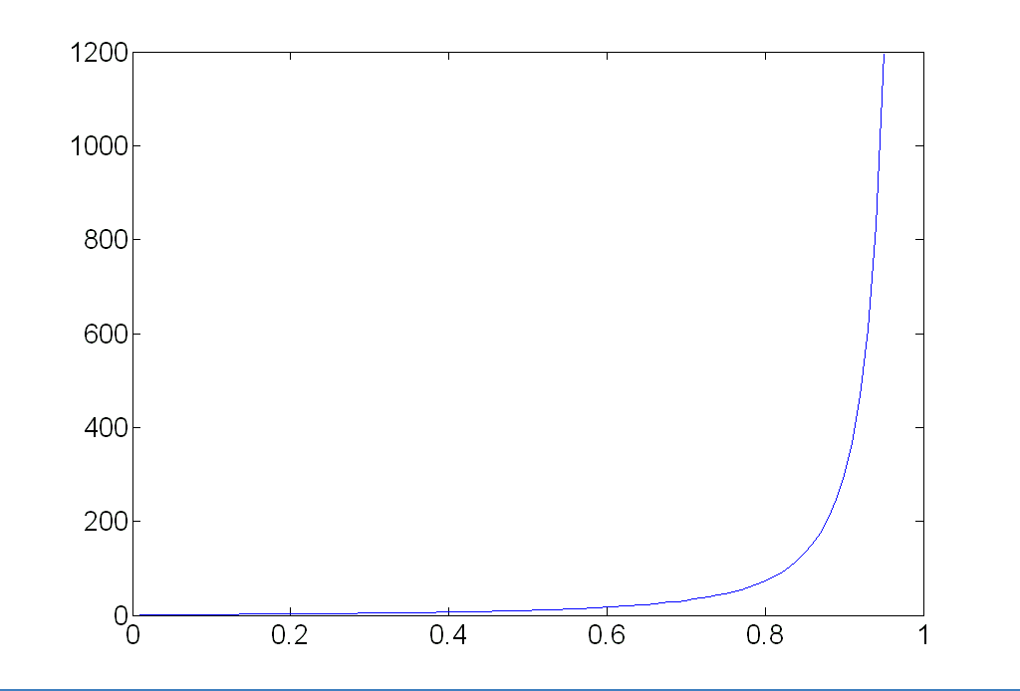
RANSAC: Choosing the parameters
Number of samples vs. outlier ratio:
 | proportion of outliers e
s | 5% | 10% | 20% | 25% | 30% | 40% | 50%
2 | 2 | 3 | 5 | 6 | 7 | 11 | 17
3 | 3 | 4 | 7 | 9 | 11 | 19 | 35
4 | 3 | 5 | 9 | 13 | 17 | 34 | 72
5 | 4 | 6 | 12 | 17 | 26 | 57 | 146
6 | 4 | 7 | 16 | 24 | 37 | 97 | 293
7 | 4 | 8 | 20 | 33 | 54 | 163 | 588
8 | 5 | 9 | 26 | 44 | 78 | 272 | 1177
Source: M. Pollefeys

Slide 39
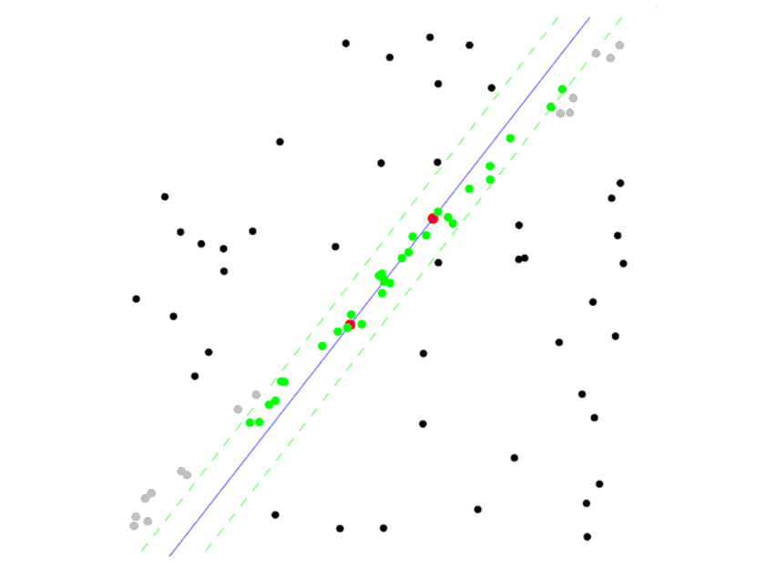
RANSAC pros and cons
Pros
Simple and general
Applicable to many different problems
Often works well in practice
Cons
Lots of parameters to tune
Doesn’t work well for low inlier ratios (too many iterations, or can fail completely)
Can’t always get a good initialization of the model based on the minimum number of samples

Slide 40
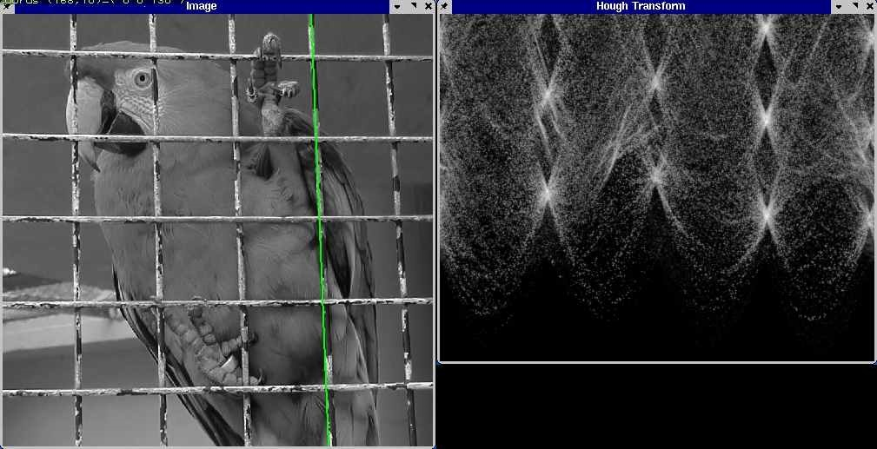
Fitting: Overview
Least squares line fitting
Robust fitting
RANSAC
Hough transform

Slide 41
Hough transform
Possibly the earliest voting scheme – but still useful!
Discretize parameter space into bins
For each feature point in the image, put a vote in every bin in the parameter space that could have generated this point
Find bins that have the most votes
Image space
Hough parameter space
P.V.C. Hough, Machine Analysis of Bubble Chamber Pictures, Proc. Int. Conf. High Energy Accelerators and Instrumentation, 1959

Slide 42

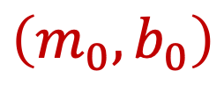



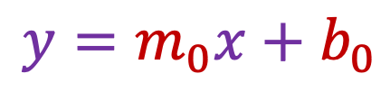
Hough transform
What does a line in the image space correspond to?
A point in the parameter space
$$y$$
$$m$$
$$y=m_{0}x+b_{0}$$
$$\left(m_{0},b_{0}\right)$$
$$x$$
$$b$$
Image space
Parameter space

Slide 43
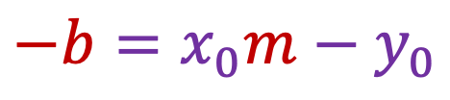
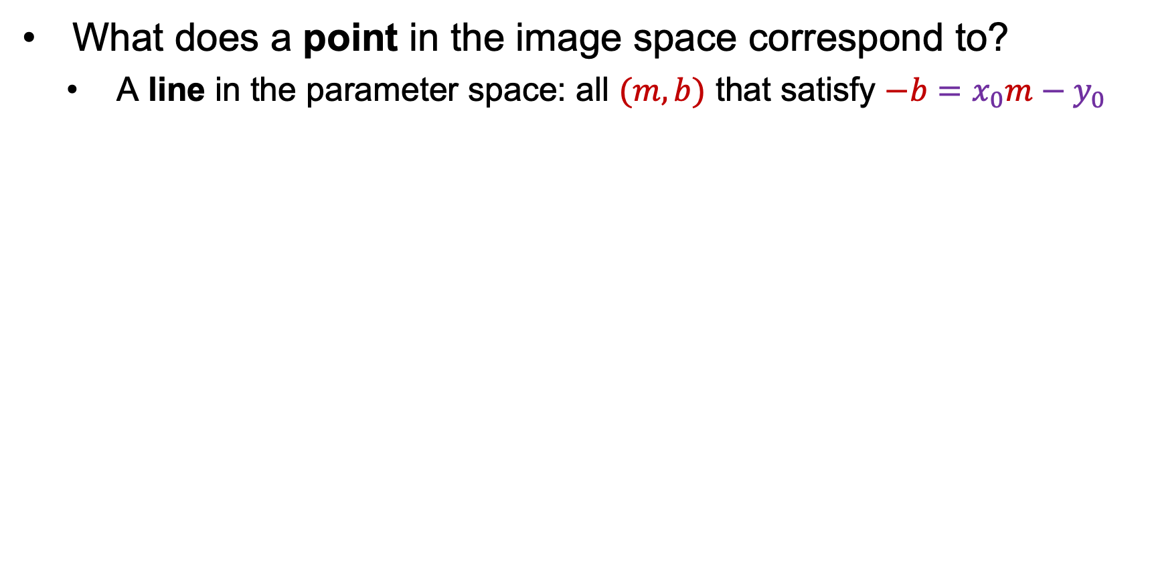
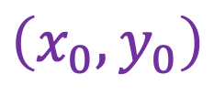
Hough transform
What does a point in the image space correspond to?
A line in the parameter space: all $(m,b)$ that satisfy $−b=x_{0}m−y_{0}$
$$y$$
$$m$$
$$−b=x_{0}m−y_{0}$$
$$\left(x_{0},y_{0}\right)$$
$$x$$
$$b$$
Image space
Parameter space

Slide 44

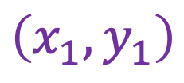
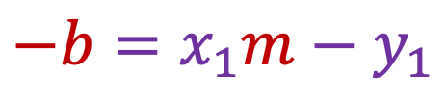
Hough transform
What about two points in the image space?
A point in the parameter space, corresponding to the unique line that passes through both points
$$y$$
$$m$$
$$\left(x_{1},y_{1}\right)$$
$$−b=x_{0}m−y_{0}$$
$$−b=x_{1}m−y_{1}$$
$$\left(x_{0},y_{0}\right)$$
$$x$$
$$b$$
Image space
Parameter space

Slide 45
Hough transform
What about many points in the image space?
Plot all the lines in the parameter space and try to find a spot where a large number of them intersect
$$y$$
$$m$$
$$x$$
$$b$$
Imge space
Parameter space

Slide 46



Parameter space representation
In practice, we don’t want to use the $(m,b)$ space!
Unbounded parameter domains
Vertical lines require infinite $m$
Alternative: polar representation
Each image point $(x,y)$ yields a sinusoid in the $(θ,ρ)$ parameter space
$$x cos θ+y\sin{θ}=ρ$$

Slide 47


Algorithm outline
Initialize accumulator $H$ to all zeros
For each feature point $(x,y)$ For $θ = 0$to $180$ $ρ = x cos⁡θ + y sin⁡θ$ $H(θ, ρ) += 1$
Find the value(s) of $(θ, ρ)$where $H(θ, ρ)$ is a local maximum (perform NMS on the accumulator array)
The detected line in the image is given by $ρ = x cos⁡θ + y sin⁡θ$
θ
ρ

Slide 48



Incorporating image gradients
For each edge point $(x,y)$ $θ =$ gradient orientation at $(x,y)$ $ρ = x cos⁡θ + y sin⁡θ$ $H(θ, ρ) += 1$

Slide 49

Basic illustration
features
votes
Hough transform demo
Notes:
Figure 15.1, top half. Note that most points in the vote array are very dark, because they
get only one vote.

Slide 50


Other shapes
Square
Circle

Slide 51


Several lines

Slide 52
A more complicated image
Source

Slide 53

Effect of noise
features
votes
Notes:
This is 15.1 lower half

Slide 54
Effect of noise
features
votes
Peak gets fuzzy and hard to locate
Notes:
This is 15.1 lower half

Slide 55

Effect of noise
Number of votes for a line of 20 points with increasing noise:
Notes:
This is the number of votes that the real line of 20 points gets with increasing noise (figure15.3)

Slide 56

Effect of outliers
features
votes
Uniform noise can lead to spurious peaks in the array
Notes:
15.2; main point is that lots of noise can lead to large peaks in the array

Slide 57

Effect of outliers
As the level of uniform noise increases, the maximum number of votes increases too:
Notes:
Figure 15.4; as the noise increases in a picture without a line, the number of points in the max cell goes
up, too

Slide 58
Dealing with noise
How to choose a good grid discretization?
Too coarse: large votes obtained when too many different lines correspond to a single bucket
Too fine: miss lines because some points that are not exactly collinear cast votes for different buckets
Increment neighboring bins (smoothing in accumulator array)
Try to get rid of irrelevant features
E.g., take only edge points with significant gradient magnitude

Slide 59
Hough transform for circles
How many dimensions will the parameter space have?
Given an unoriented edge point, what are all possible bins that it can vote for?
What about an oriented edge point?

Slide 60
Hough transform for circles
image space
Hough parameter space
r
y
(x,y)
x
x
y

Slide 61
Hough transform: Pros and cons
Pros
Can deal with non-locality and occlusion
Can detect multiple instances of a model
Some robustness to noise: noise points unlikely to contribute consistently to any single bin
Leads to a surprisingly general strategy for object localization (more on this next)
Cons
Complexity increases exponentially with the number of model parameters – in practice, not used beyond three or four dimensions
Non-target shapes can produce spurious peaks in parameter space
It’s hard to pick a good grid size

Slide 62
Fitting: Overview
Least squares line fitting
Robust fitting
RANSAC
Hough transform
Generalized Hough transform

Slide 63
Generalized Hough transform
We want to find a template defined by its reference point (center) and several distinct types of landmark points in stable spatial configuration
Template
c
Notes:
-The center or reference point is not necessarily a visible point, it’s just the “origin” of the shape’s coordinate system
-The landmark points don’t have to be located on the boundary, they just need to be in a stable spatial configuration w.r.t. the center
- The types of landmark points correspond to “visual words” or features that have a distinct local appearance (how to identify such visual words will be discussed later in the course)

Slide 64
Generalized Hough transform
Template representation: for each type of landmark point, store all possible displacement vectors towards the center
Model
Template

Slide 65
Generalized Hough transform
Detecting the template:
For each feature in a new image, look up that feature type in the model and vote for the possible center locations associated with that type in the model
Model
Test image
Notes:
Note that some of the features present in the template may actually be absent in the test image. The positions of the features can move around; new “noise” or “clutter” features can be added.
The small circles represent votes for possible center location.

Slide 66

Application in recognition
Index displacements by “visual codeword”
visual codeword with displacement vectors
training image
B. Leibe, A. Leonardis, and B. Schiele, Combined Object Categorization and Segmentation with an Implicit Shape Model, ECCV Workshop on Statistical Learning in Computer Vision 2004
Notes:
This is not just some useless historic idea, but is actually extensively used in modern recognition.

Slide 67

Application in recognition
Index displacements by “visual codeword”
test image
B. Leibe, A. Leonardis, and B. Schiele, Combined Object Categorization and Segmentation with an Implicit Shape Model, ECCV Workshop on Statistical Learning in Computer Vision 2004

Slide 68
Implicit shape models: Training
Build codebook of patches around extracted interest points using clustering (more on this later in the course)

Slide 69
Implicit shape models: Training
Build codebook of patches around extracted interest points using clustering
Map the patch around each interest point to closest codebook entry

Slide 70
Implicit shape models: Training
Build codebook of patches around extracted interest points using clustering
Map the patch around each interest point to closest codebook entry
For each codebook entry, store all positions it was found, relative to object center

Slide 71

Implicit shape models: Testing
Given test image, extract patches, match to codebook entry
Cast votes for possible positions of object center
Search for maxima in voting space
Extract weighted segmentation mask based on stored masks for the codebook occurrences

Slide 72












Additional examples
B. Leibe, A. Leonardis, and B. Schiele, Robust Object Detection with Interleaved Categorization and Segmentation, IJCV 77 (1-3), pp. 259-289, 2008.

Slide 73

A more recent example: Voting for detection
J. Dai et al. R-FCN: Object Detection via Region-based Fully Convolutional Networks. arXiv 2016

Slide 74

A more recent example: Voting for detection
J. Dai et al. R-FCN: Object Detection via Region-based Fully Convolutional Networks. arXiv 2016

Slide 75

A more recent example: Voting for detection
J. Dai et al. R-FCN: Object Detection via Region-based Fully Convolutional Networks. arXiv 2016

Slide 76

Convolutional Hough matching networks
J. Min and M. Cho. Convolutional Hough matching networks. CVPR 2021

